Slide 1

Oregon State University NASA USLI Progress Report
Mark Bereza
Joseph Struth
Kevin Turkington
11/30/2017

Slide 2
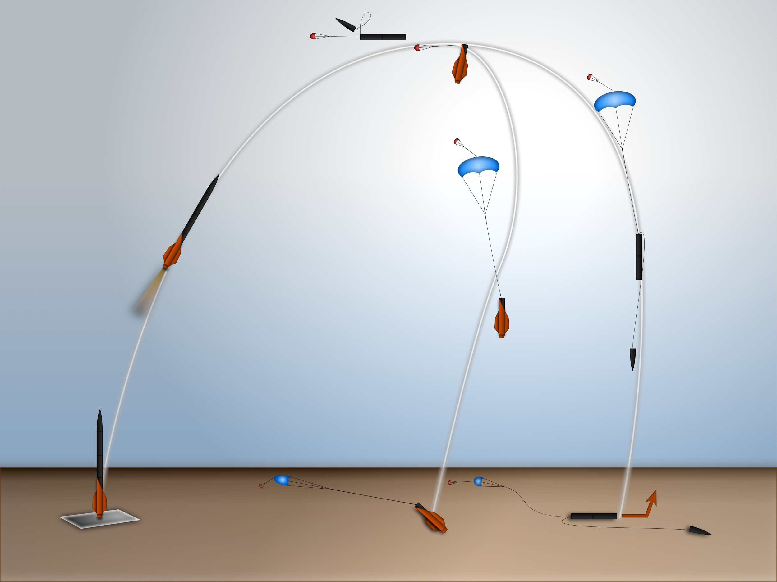
Mission Overview
Payload and motor sections separate at apogee
Payload section drogue ejects first
Drogue Velocity:
75 ft/s
Aerodynamics/Recovery System:
Time delay before motor
section drogue ejection
Main Deploys at
750 ft AGL
Payload rover ejects
Notes:
General Overview

Slide 3

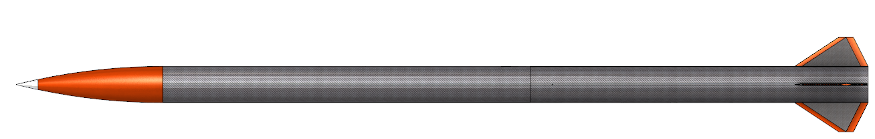
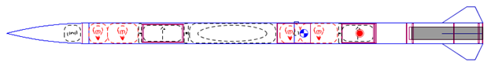
Overview: Rocket Design
45.2 lbs at launch
5” diameter
116” length
Notes:
General Overview

Slide 4
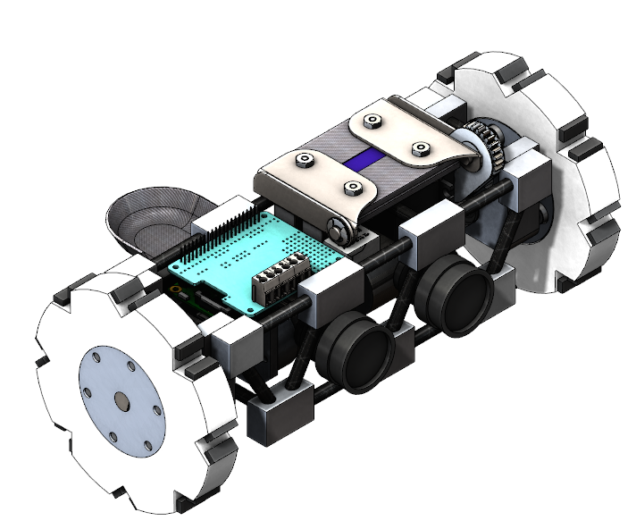
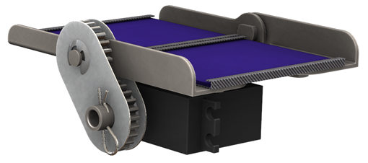
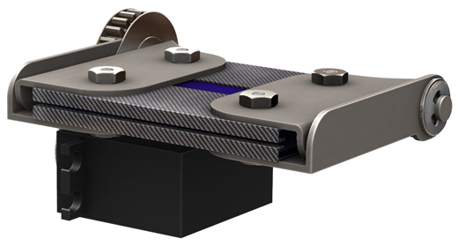
Overview: Rover Payload
Notes:
Component Overview: Rover

Slide 5
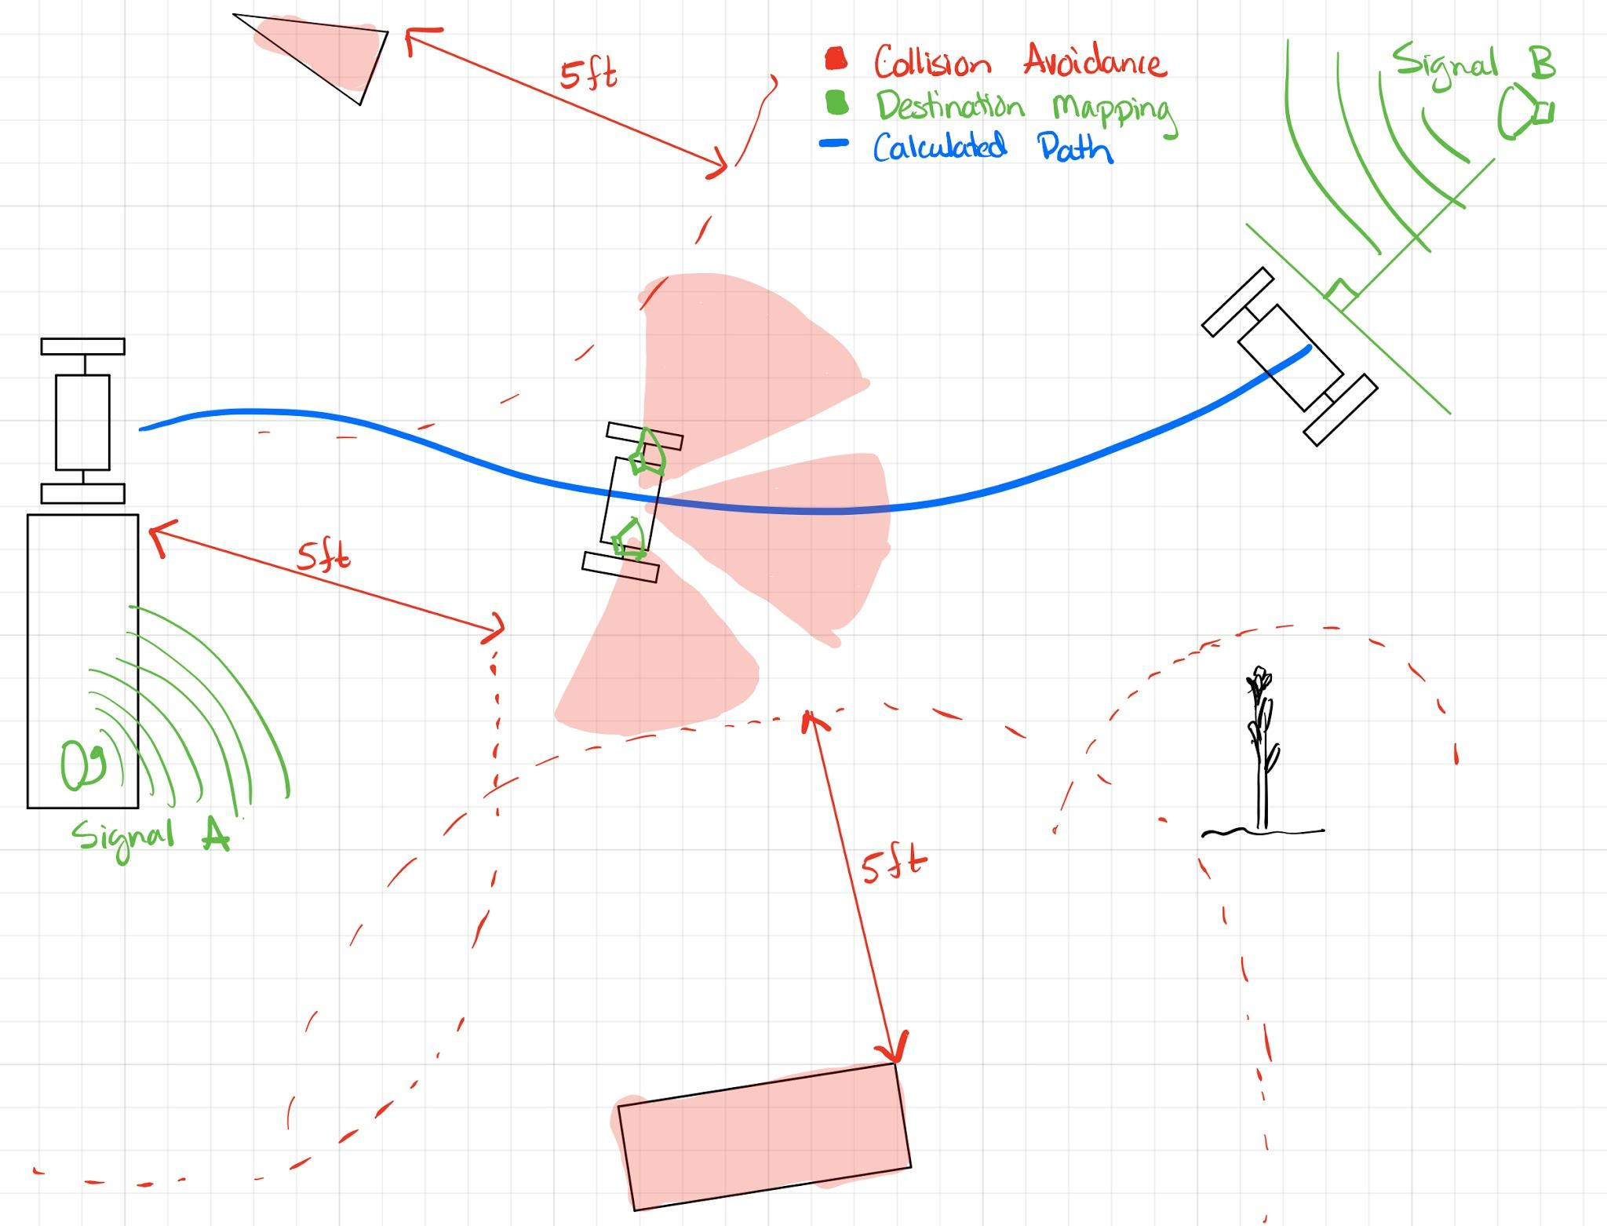
Overview: Rover Payload
Rocket body identification: GPS and ultrasound
Collision avoidance: ultrasound
Absolute and relative direction: IMU w/ nine degrees of freedom:
Magnetometer w/ X,Y,Z
Accelerometer w/ X,Y,Z
Gyroscope w/ X,Y,Z
Wheels can move independently forwards and backwards
Three levels of movement algorithms
Notes:
Component Overview: Rover

Slide 6
Overview: Rover Software
Three movement algorithms of decreasing complexity:
SLAM: determine location of rocket body and path find a route at least 5 feet from the rocket body
Obstacle avoidance: use combination of IMU and sonar sensors to avoid obstacles and steep elevation changes while moving away from rocket body
Basic movement: face away from rocket body and move until rover no longer can.

Slide 7
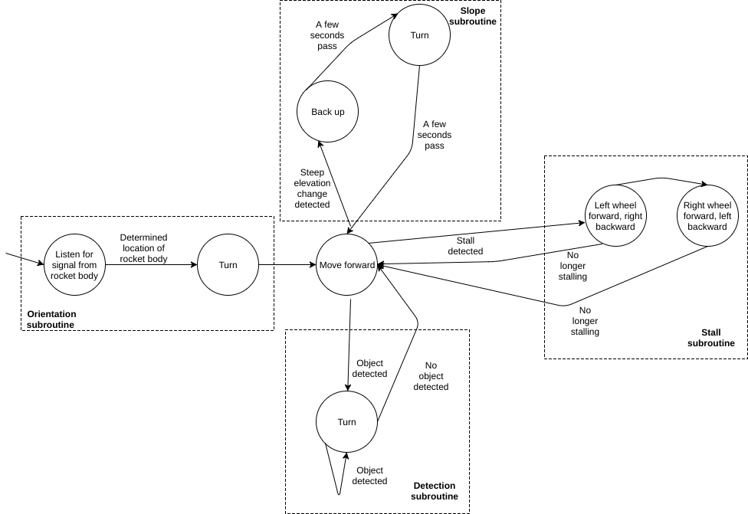
Overview: Rover Software, Cont.

Slide 8
Overview: Avionics Data Logging Module
Responsible for collection of in-flight sensor data.
Data collected from sensors via serial communication, stored in flash memory, and displayed post-flight on team website.
Avionics Sensors
RF Transceiver
GPS
Power Supply
GPS Antenna
RF Antenna
Micro Controller
Notes:
Component Overview: Avionics

Slide 9
Overview: Website
One place for all USLI team information
Contact information
Photos
Team role
Provides deliverables for NASA
Presentation slides and documents for PDR, CDR, FRR, etc.
Provides educational outreach information
Notes:
Component Overview: Website

Slide 10
Stumbling Blocks: General
PDR areas of improvement:
Safety (got 40% of total points)
Solution: increased focus on safety by all team members, rewrite environmental safety bullet points in document (misunderstood expectations)
Notes:
Component Overview: Avionics

Slide 11
Stumbling Blocks: General, Cont.
Underclassmen leaving or losing interest:
Result of this term being almost entirely designing, documentation, and planning
Solution: Now that parts have arrived and more hands-on work is available, we can begin trying to reach out to underclassmen again and promise them more fun work to do than simply attending design meetings

Slide 12
Stumbling Blocks: Rover
ROS learning curve is greater than anticipated.
Solution: Work on simulations, using Brad’s ROS simulation code from his robotics class.
Waiting to start development until testbed was completed.
Solution: Testbed finished at the end of November.
Notes:
Component Overview: Avionics

Slide 13
Stumbling Blocks: Avionics
Waiting for parts to arrive, due to lack of funding hindered development.
Solution: Grant approved 11/28/17
Sensors were unknown , which hindered development.
Solution: Sensors decisions finalized by avionics sub-team lead on 11/03/17.
Development could not start until sensors delivered.
Solution: Started research on serial communication libraries.
Notes:
Component Overview: Avionics

Slide 14
Stumbling Blocks: Website
Details for features and website design.
Solution: Discussed with team leads during October. Design finalized before PDR was due to NASA.
Making web development work available to underclassmen USLI team members.
Solution: Github issues.
Notes:
Component Overview: Avionics

Slide 15
Progress: General
PDR score sheets are in…
We are top 20% in the competition
Equates to 11th out of 50 teams!
Contributions:
Kevin Turkington: Website/Verification Plan
Joseph Struth: Website/Verification Plan
Mark Bereza: Verification Plan/Software Design
Notes:
Updates/Progress: General

Slide 16
Progress: Rover
Setup Raspberry Pi playground online with Raspbian installed
Did some ROS tutorials for practice
Setup ROS on Pi and begin creating simulations.
Notes:
Rover Progress

Slide 17
Progress: Rover Software Design Decisions
Software Framework
ROS (Robot Operating System)
MRPT (Mobile Robot Programming Toolkit)
MRDS (Microsoft Robotics Development Studio)
Operating System
Ubuntu
Raspbian
Windows 10 for IoT
Languages
C++
Python
C#
Notes:
Rover Progress

Slide 18
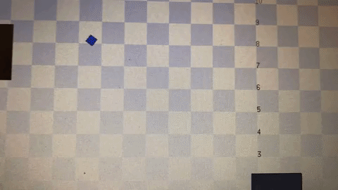
Progress: Rover Simulations
Notes:
Progress: Rover

Slide 19
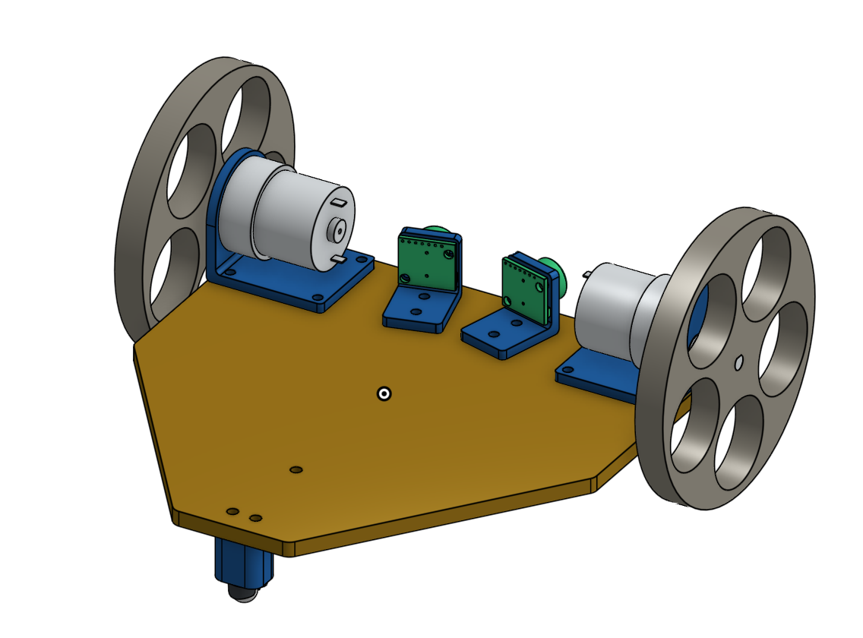
Progress: Rover
3D printed parts: Motor mounts, Sonar mounts, Ball caster for back wheel.
Laser Cut: Plywood 7/32”
Notes:
Rover Progress

Slide 20
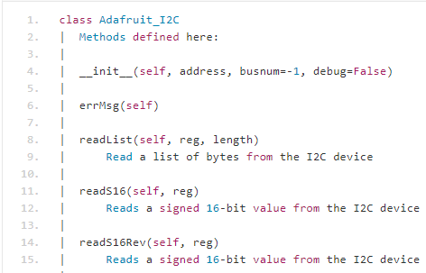
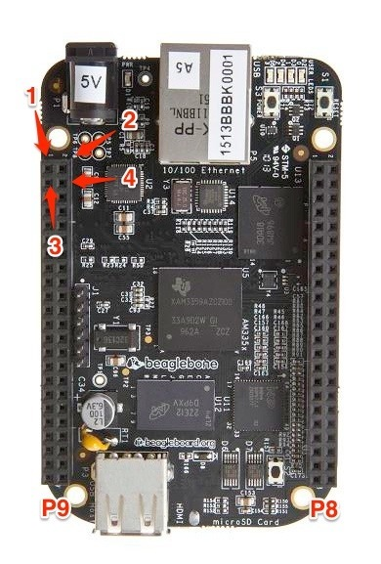
Progress: Data Logger
Adafruit Python IO Library (made for BeagleBone Black):
Supports GPIO, PWM, ADC, I2C, SPI, UART
Development plan: Start with one sensor at a time reading and storing data, integrate more as they arrive.
Final system ready for subscale
Notes:
Avionics Progress

Slide 21
Progress: Website
Set up website on osuusli.com domain name
USLI team information sidebar created
Final Website designs implemented to site
Posted PDR and proposal documents on team website
Notes:
Component Overview: Avionics

Slide 22
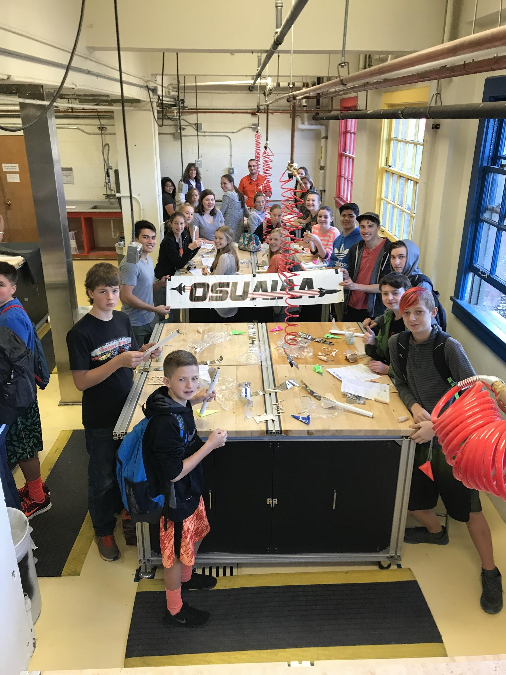
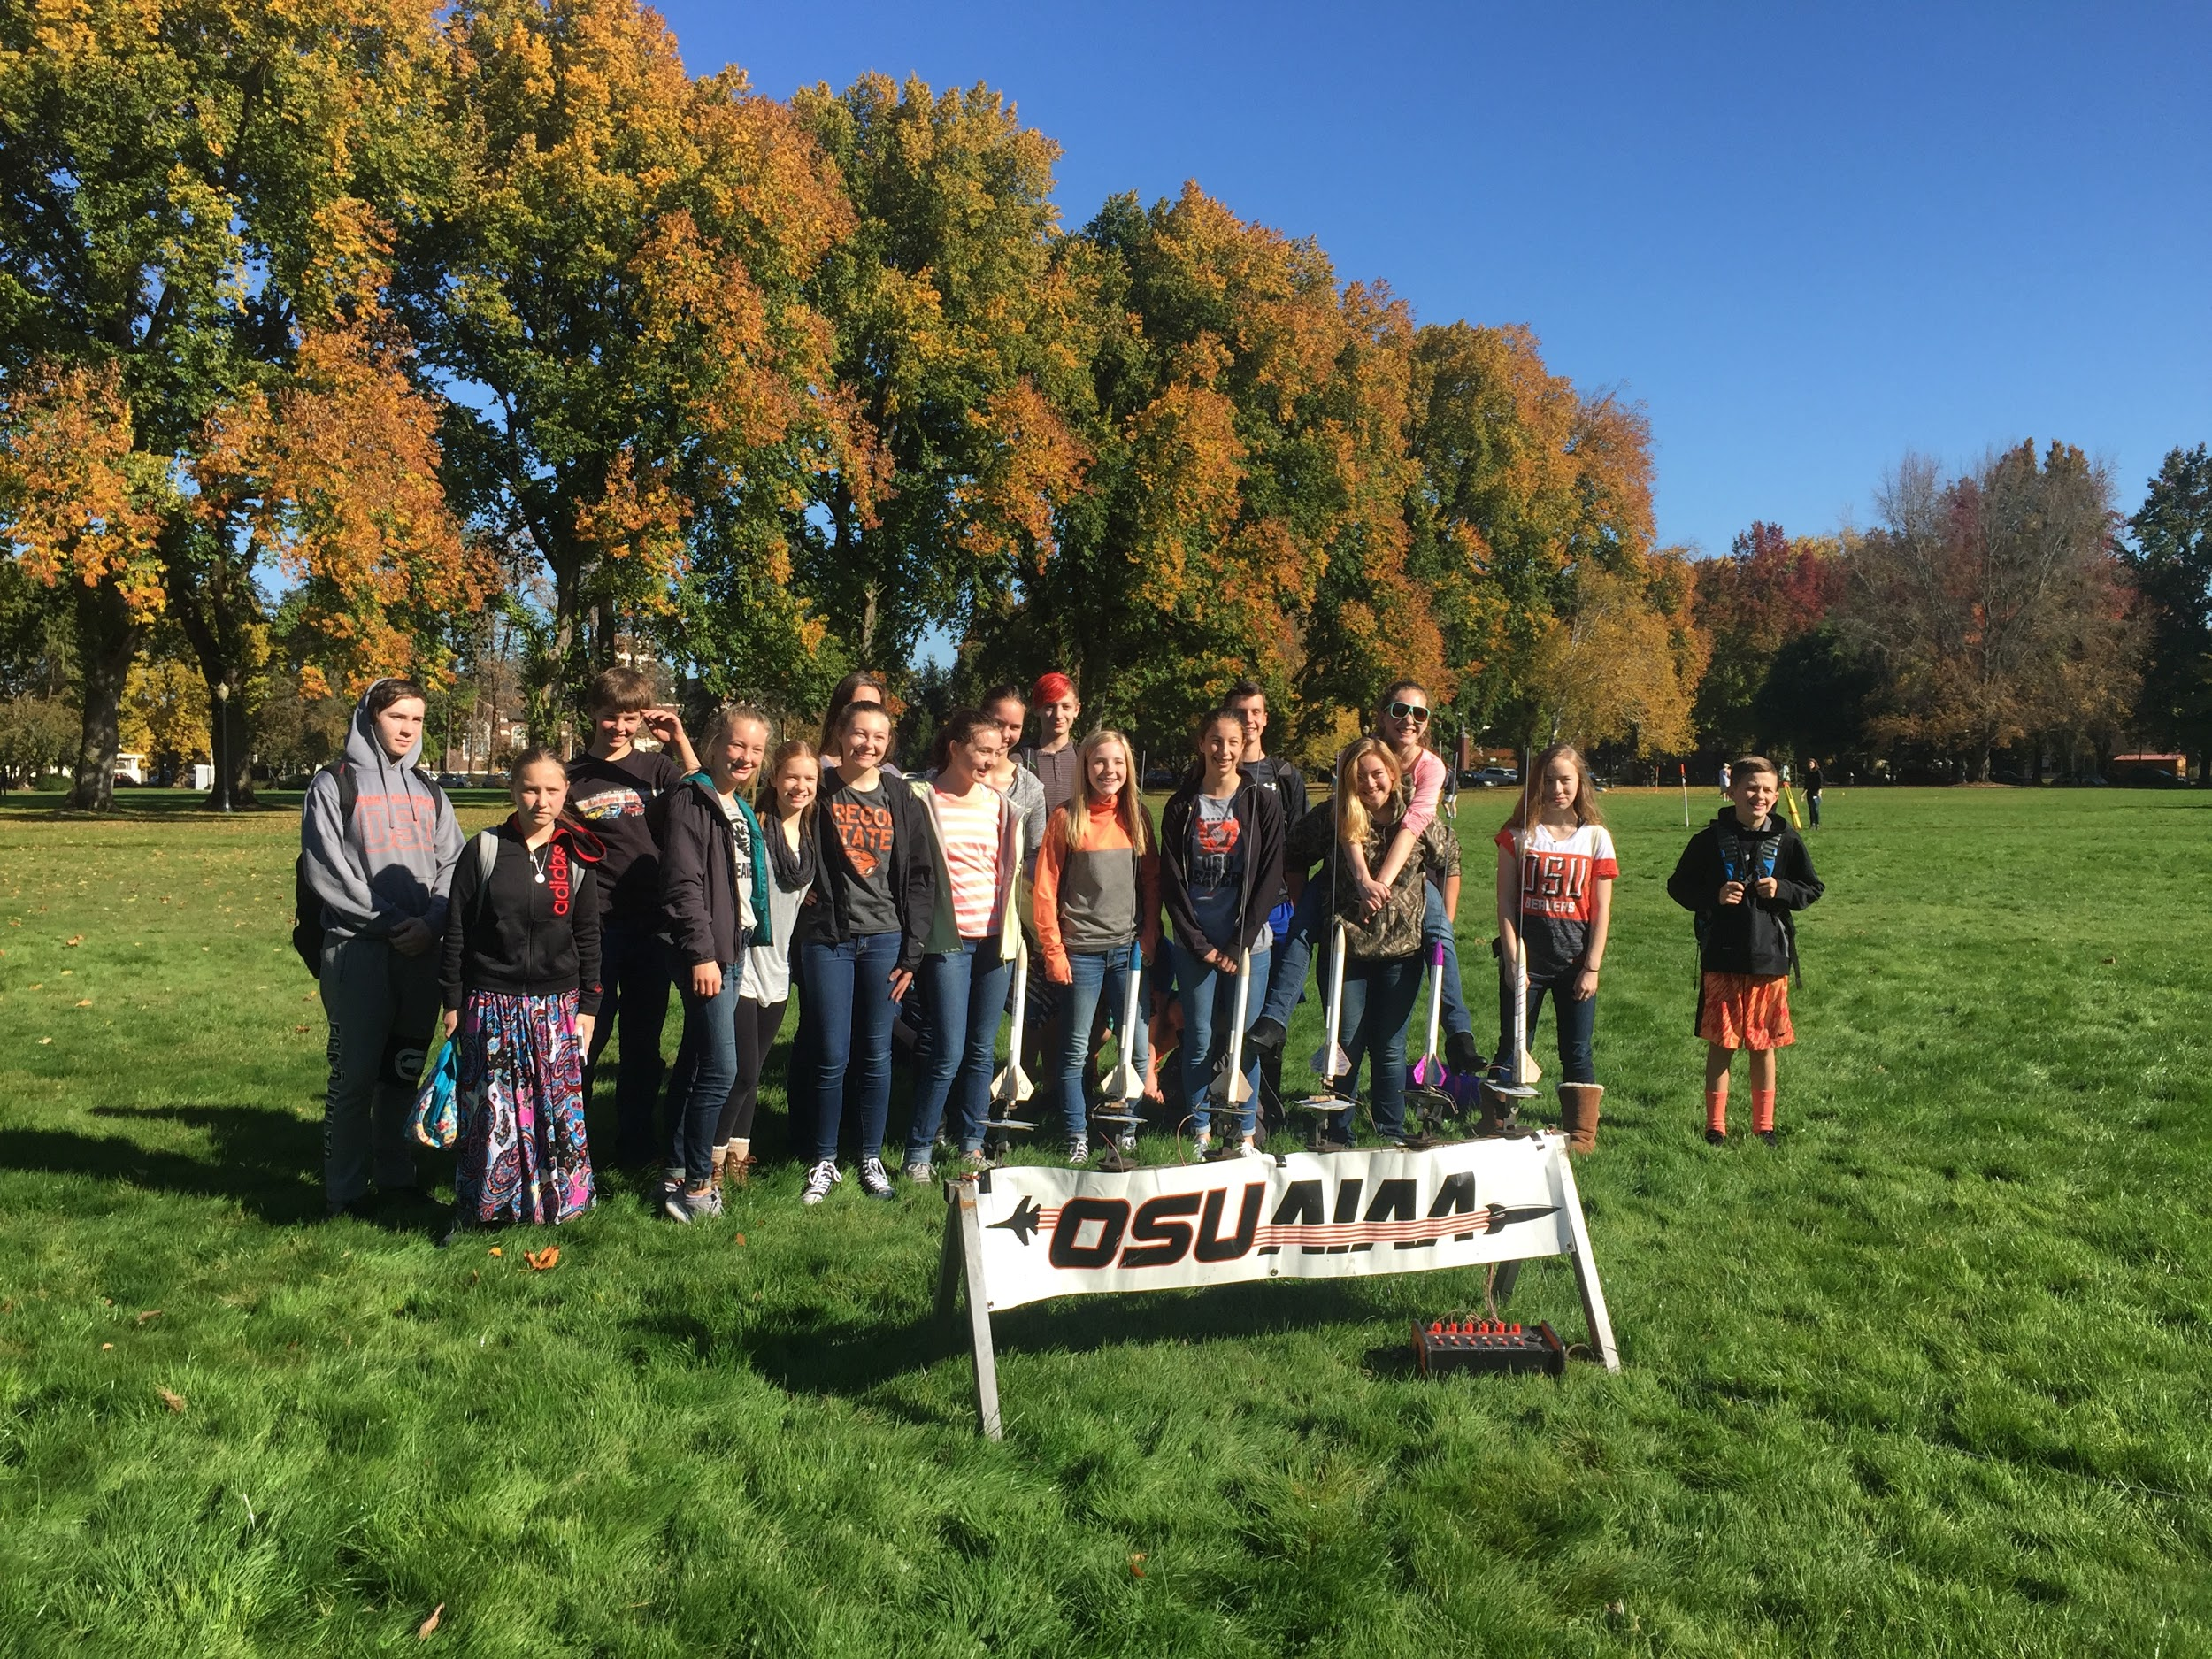
Progress: Educational Outreach
First Outreach Event:
Silver Crest School (K8) - Built and launched model rockets (A-motors) on the OSU campus after a presentation about rocketry. Provided a tour of the local AIAA chapter lab space.
Second Outreach Event: Philomath Middle School (K6-7) - Gave a presentation about rocketry and STEM at OSU. Conducted a Question and Answer period. Decorated and launched model rockets!
Future Outreach Events:
December: Sunset High Schools, Walker Middle School 13th (All Day)
All Later Months:
Coordinating schools with alumni
information and availability.
Notes:
Updates/Progress: Educational

Slide 23
Looking Forward: General
Upcoming Events:
CDR Q&A 12/1/17 @ 11:00 AM (next Friday)
Formal Design Review 12/1/17 @ 5:00 PM (next Friday)
Subscale rocket completion 12/8/17 (end of term)
Critical Design Review (CDR): January
Create Latex template for CDR document:
Assist team in compiling document and learning Latex.
Notes:
Looking forward

Slide 24
Looking Forward: Rocket
Ejection testing
5” mockup airframe currently being designed
Will determine final black powder loads/reliability
Subscale testing
Before Critical Design Review
4” diameter launch vehicle
Full scale testing
Before Flight Readiness Review
Notes:
Looking Forward /Current Status

Slide 25
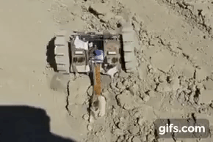
Looking Forward: Rover Payload
Testing Procedures
Slope and Soil Texture
Obstacle Course
Dust and Particle Tolerance
Inter-System Interference
Power Consumption
ARLISS: University of Tokyo, 2014
Notes:
Looking Forward/ Current Status

